Slide 1
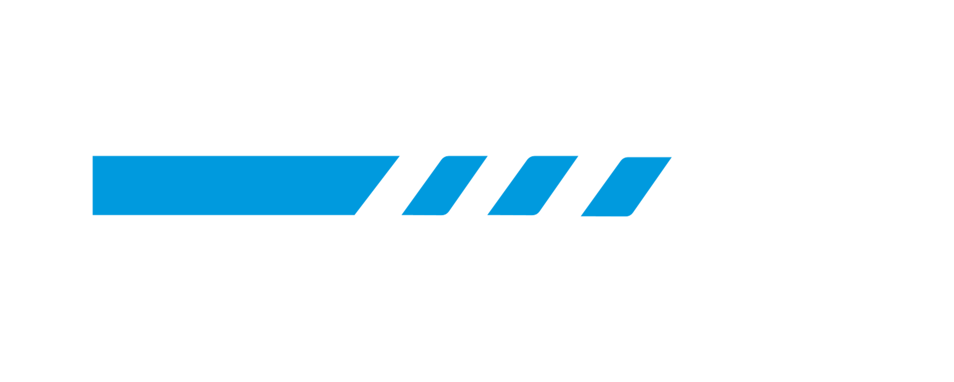
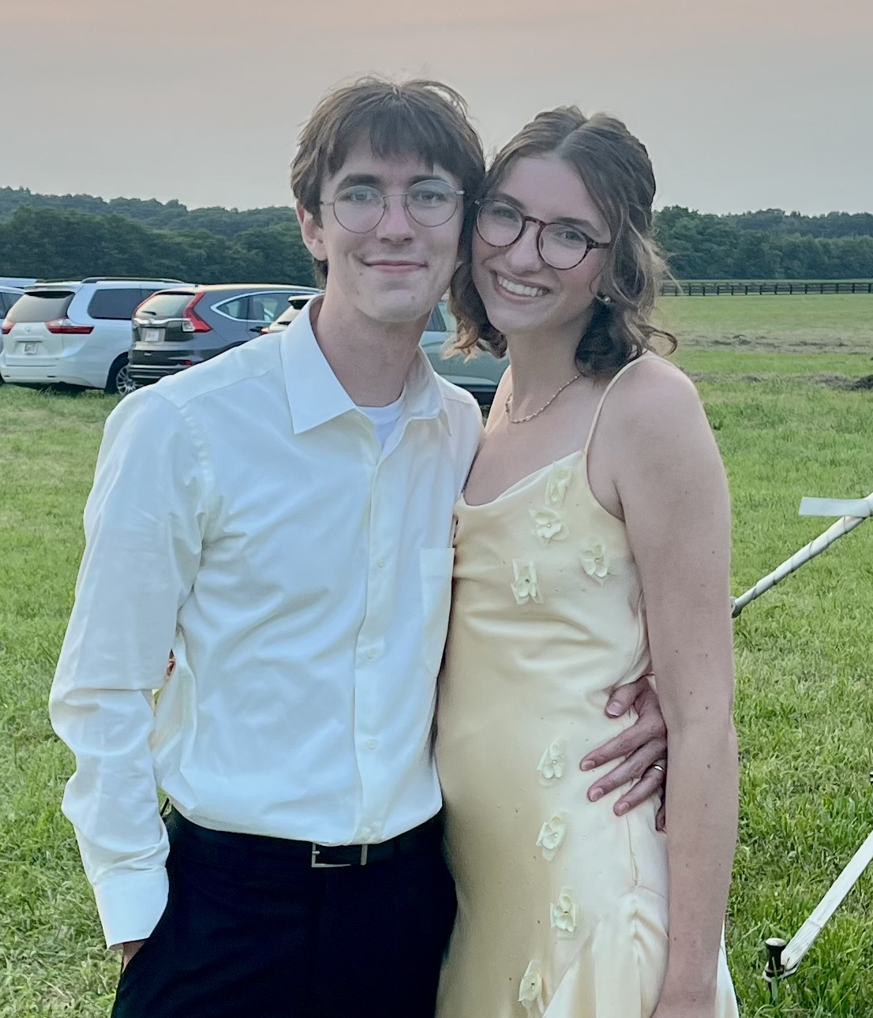
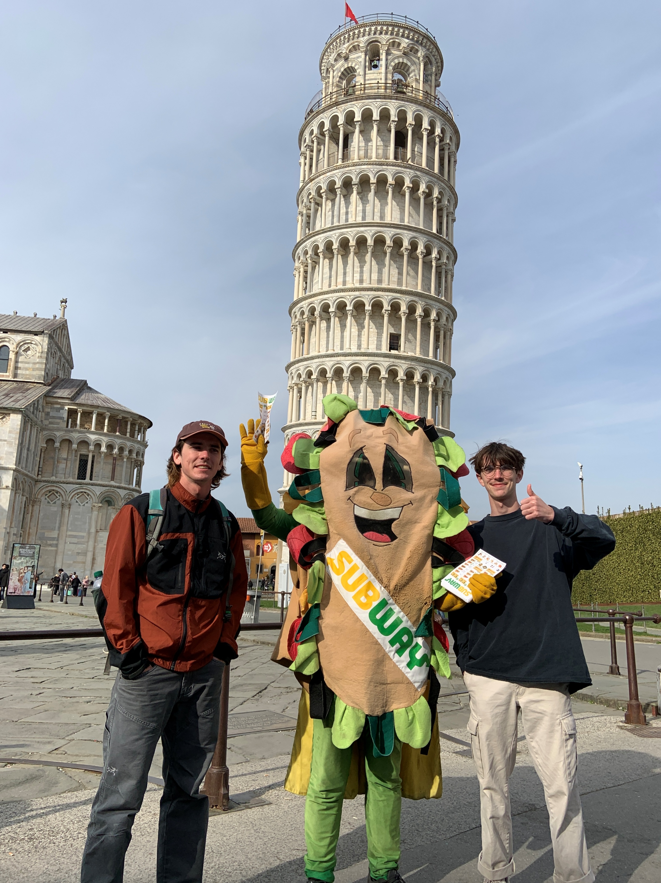
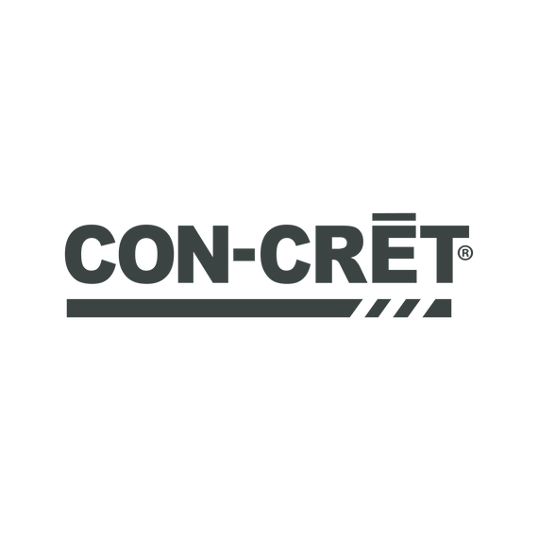
About me
Organizational Communications Major at MTSU
Graduation Date: December 2025
I love art, traveling, sports, and fashion
Matthewbutterfield.org
Notes:
Marketing intern working under Brandon

Slide 2
Project Overview
Launch a strategic merch line for CON-CRET to drive revenue,
expand brand visibility and strengthen community loyalty.
Notes:
My work this summer was to prepare for a Launch Q1 on shopify

Slide 3
Product Portfolio
Cotton T-shirt
Performance T-shirt
Hat
Shaker Bottle
Sticker Pack (3pc)

Slide 4
KPIs
Increase AOV by $15
Increase organic traffic by 20%
Minimum 4.5 star reviews on all merch products
Community: 50+ messages requesting alternate merch options
Encourage brand loyalty with products our customers want to wear

Slide 5
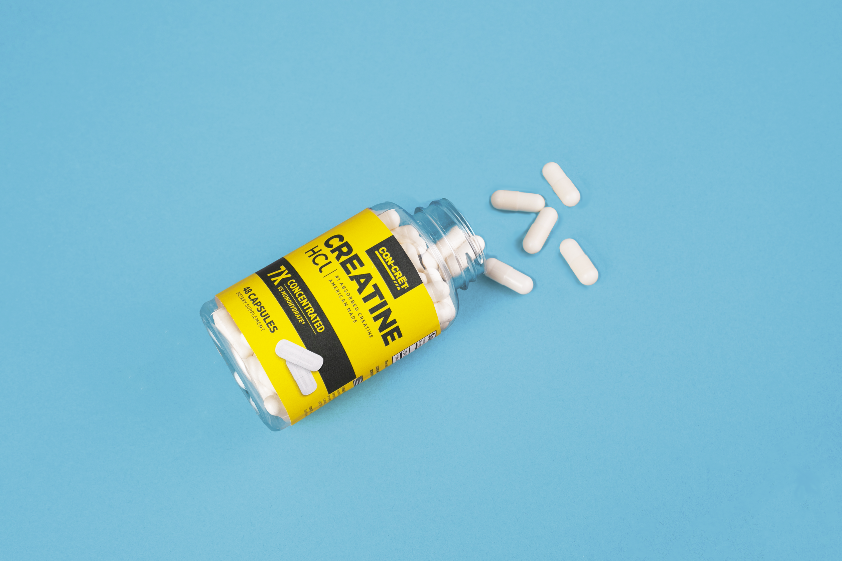

TABLE OF CONTENTS
PITCH DECK PRESENTATION
01
04
Why Merch?
Look & Feel
02
05
Competitive Audit
Vendor & Sourcing
03
06
Forecasting & Budget
Rollout Strategy
Notes:
Explain why concret should offer merch

Slide 6
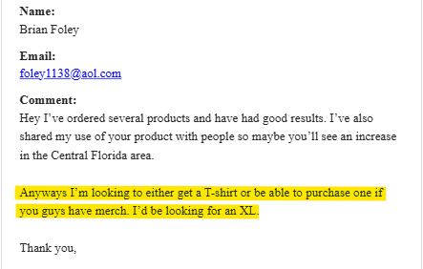
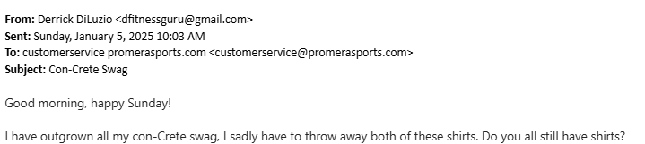
Why sell merch?
Monetary
Community
Brand new revenue stream
High margins (50%+)
Improves AOV
Encourages sales to core products
Strengthens brand ID
Creates conversation
Conversation = Conversion
Notes:
Nearly 100% of consumers say they are willing to go out of their way to get a promotional product.

Slide 7
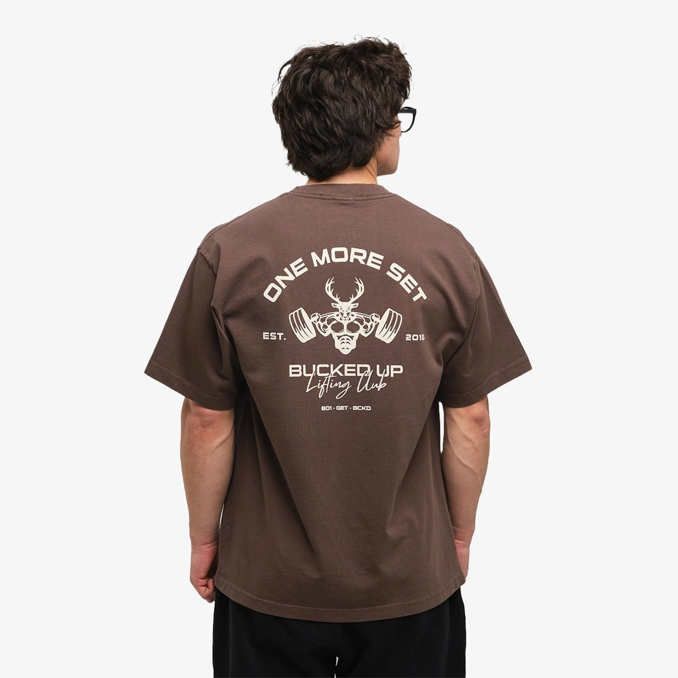
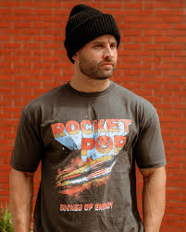
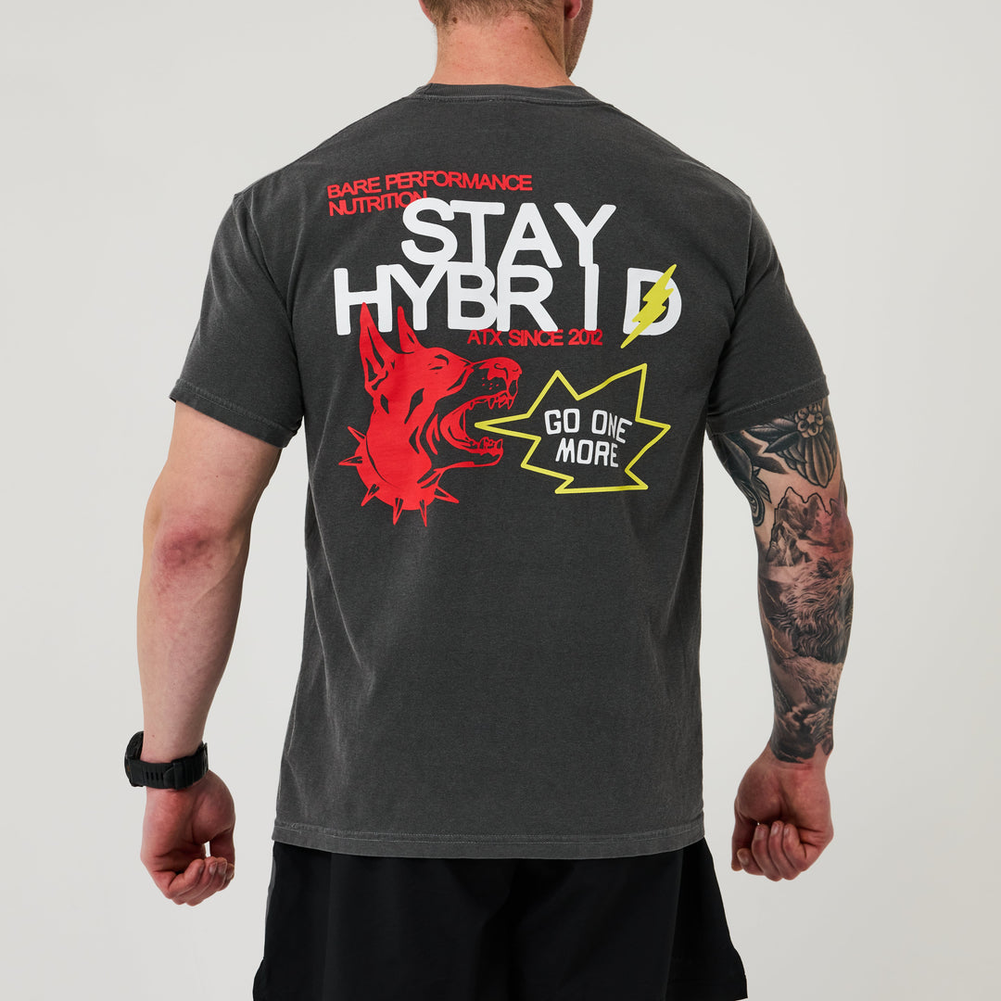
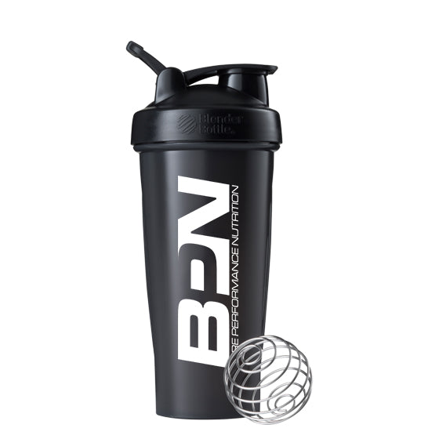
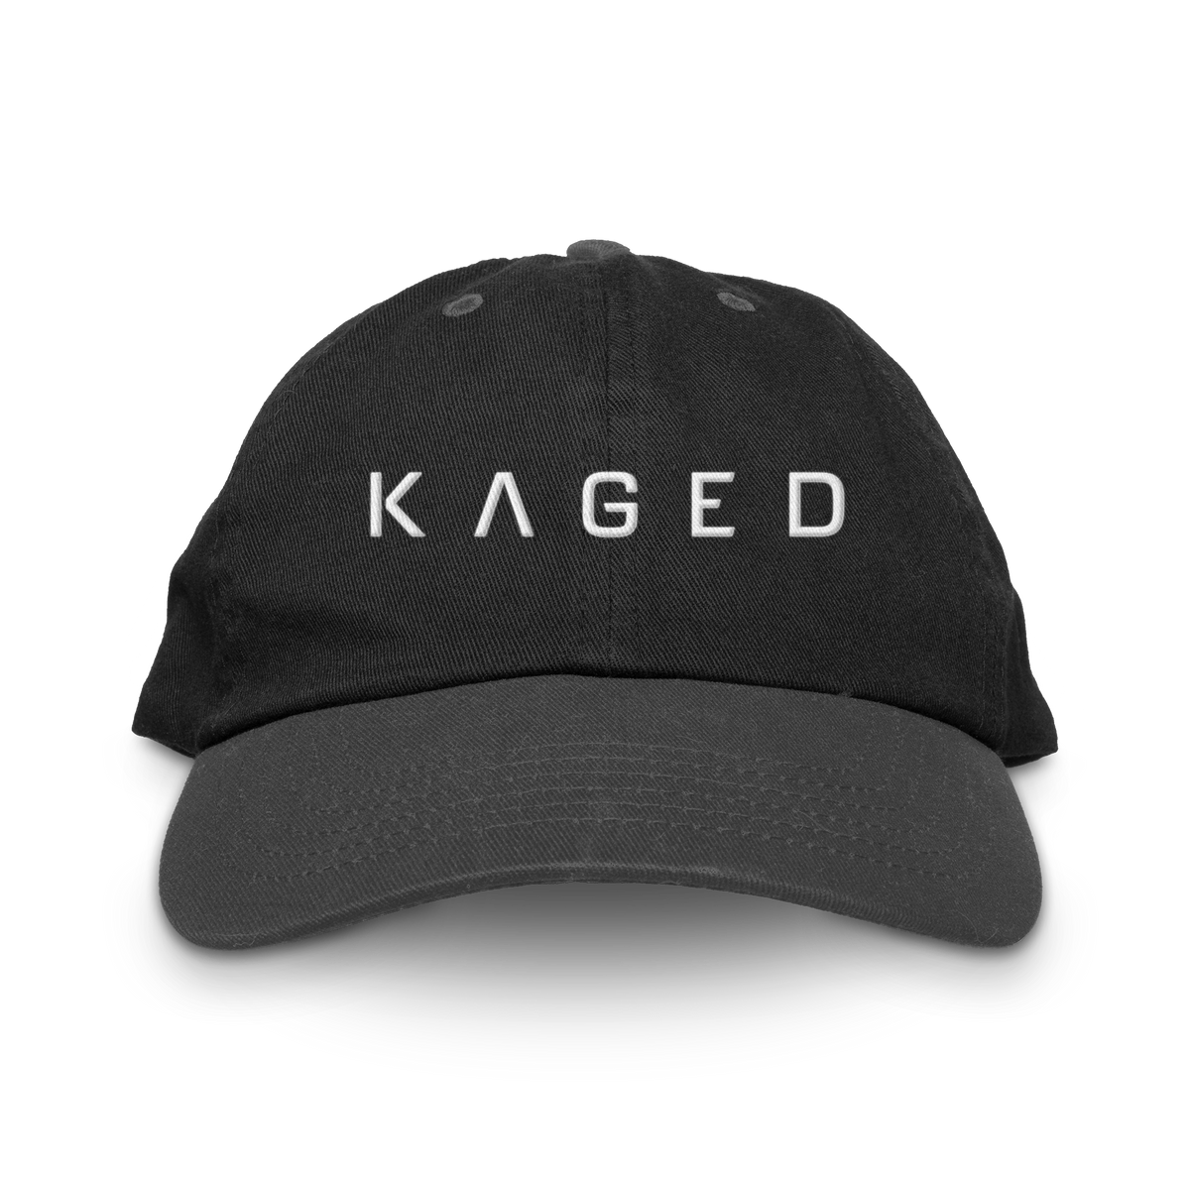
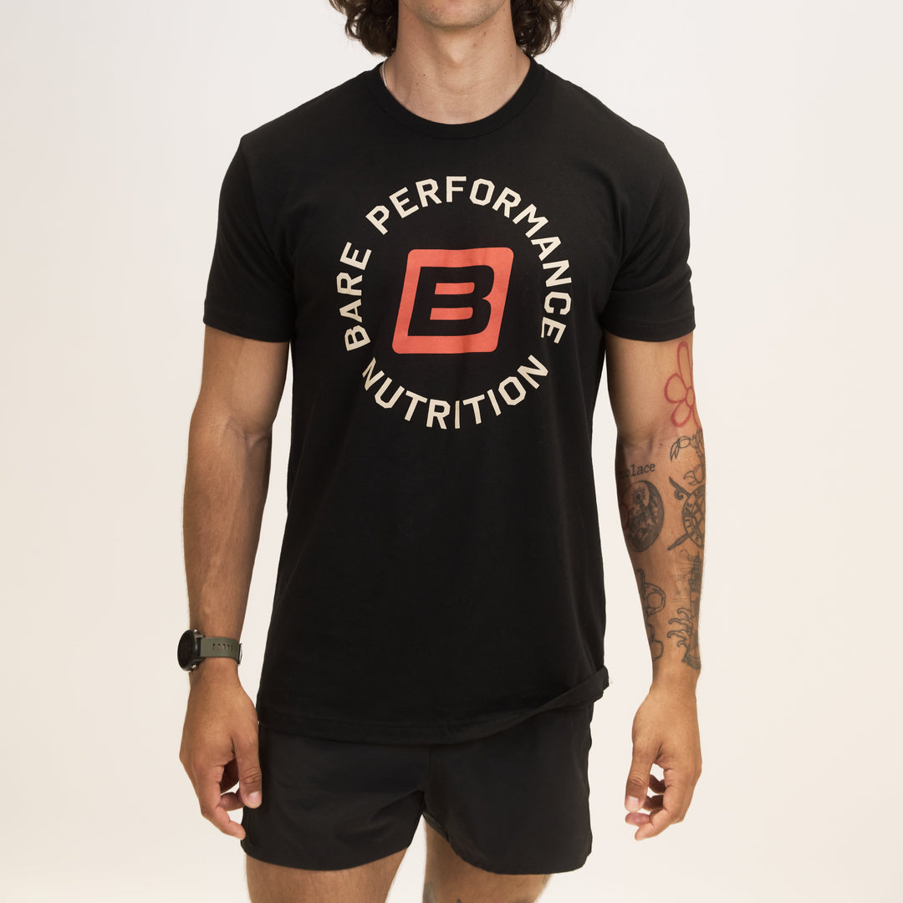
Competitive Audit
Analyzed how brands like Cellucor, BPN, and Bucked Up structure their merch offerings
Created a spreadsheet to compare pricing, product types, material quality, and overall brand alignment
Conducted social listening to understand what customers want and expect when buying merch
Used these insights to better understand how to structure CON-CRET merch according to our unique target demographic
$49.99
$34.99
$34.99
$13.99
$24.99
$24.99

Slide 8
Forecasting
Reviewed customer interest, team input, and Shopify traffic to estimate demand
Built an Excel model to forecast cost, revenue, and inventory thresholds by item
Factored in staff promo, reorder timelines, and safety stock to avoid overspending or underordering

Slide 9
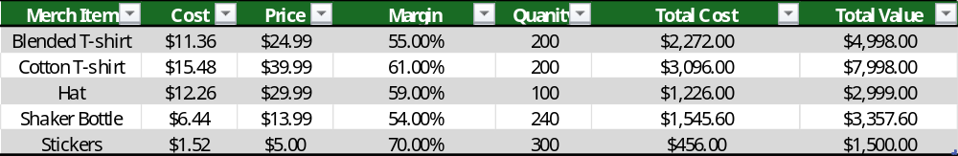
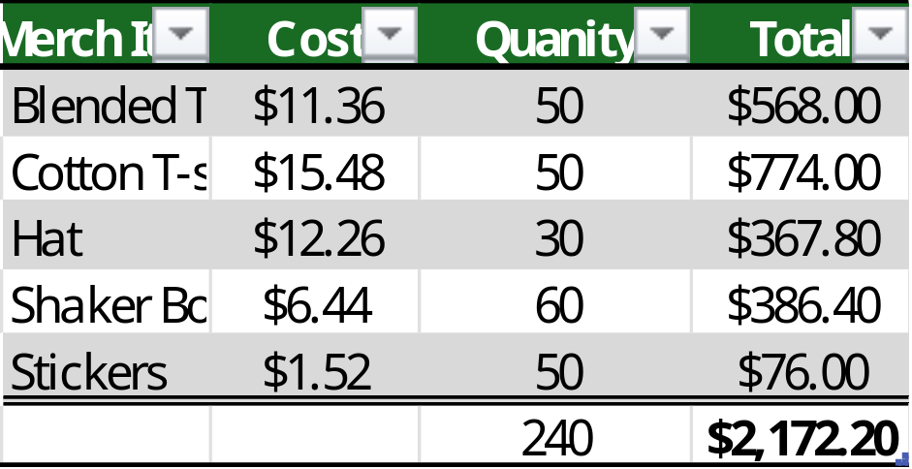
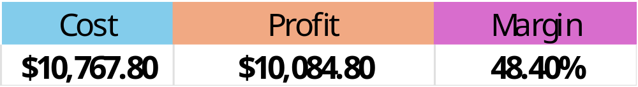
Budget
Staff & Promotion
Notes:
Based on current designs and vendor options

Slide 10
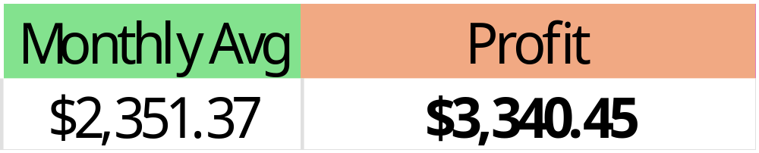
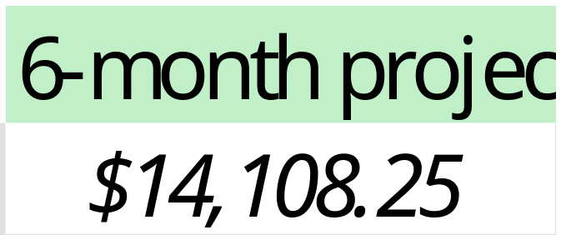
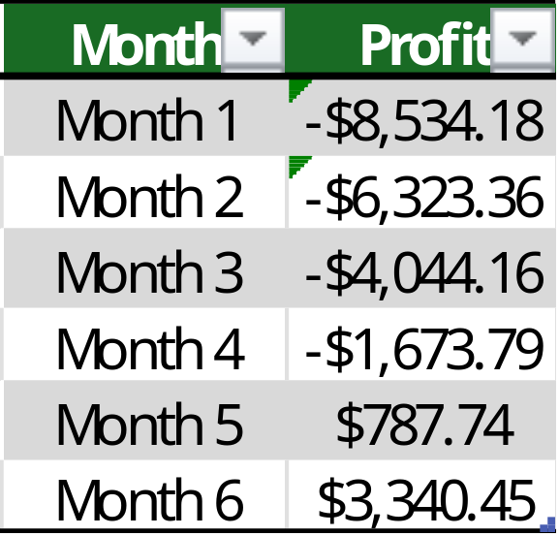
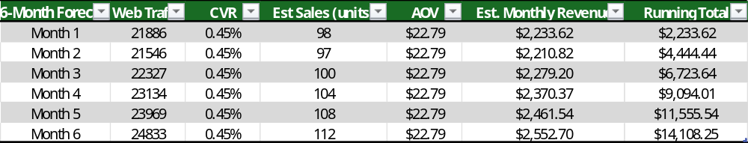
6-month Forecast
Break even Month 5
AOV is the average price of all 5 SKUs
CVR of 0.45%
Notes:
Current CVR: 2.4%
0.45% is a guesstimate
0.09% per item
Avg. 20 sales each month per SKU
Other CVRs seemed unrealistic i.e. 1% and 2.68%

Slide 11
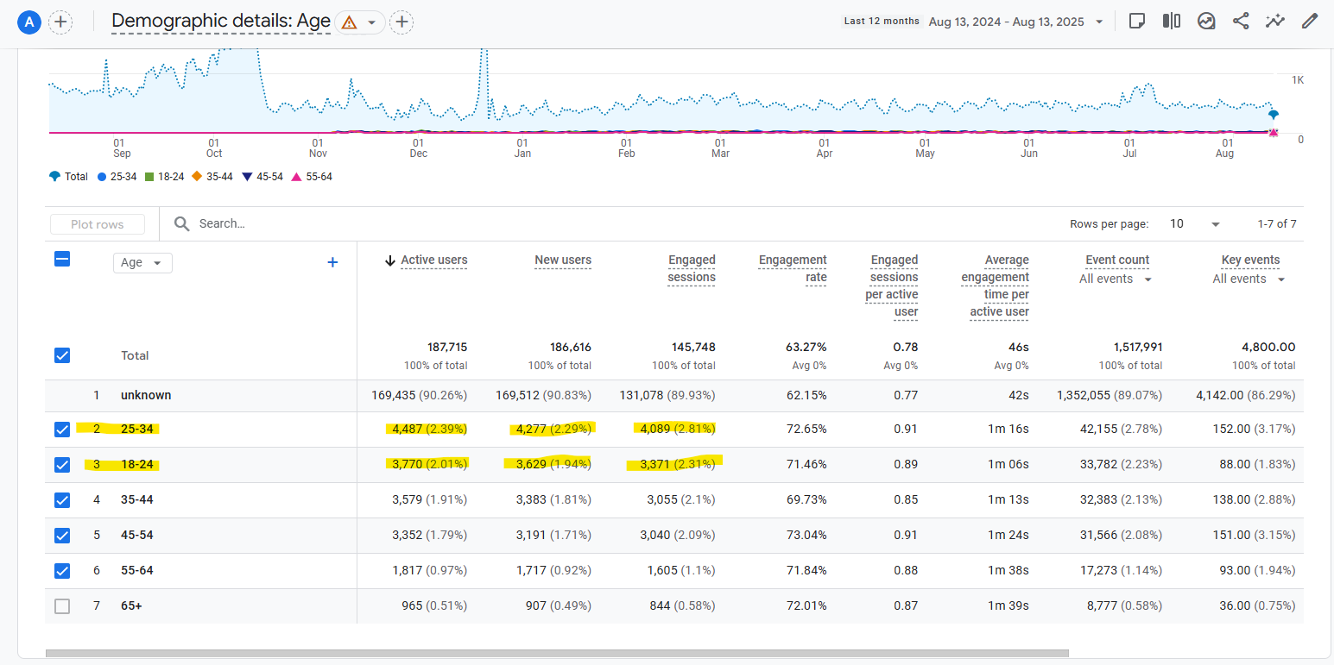
Shopify Demographic - Age
Notes:
12 month snapshot at our Shopify demographics. Most Active, new users, and engaged customers fall in Jesse’s segment.

Slide 12
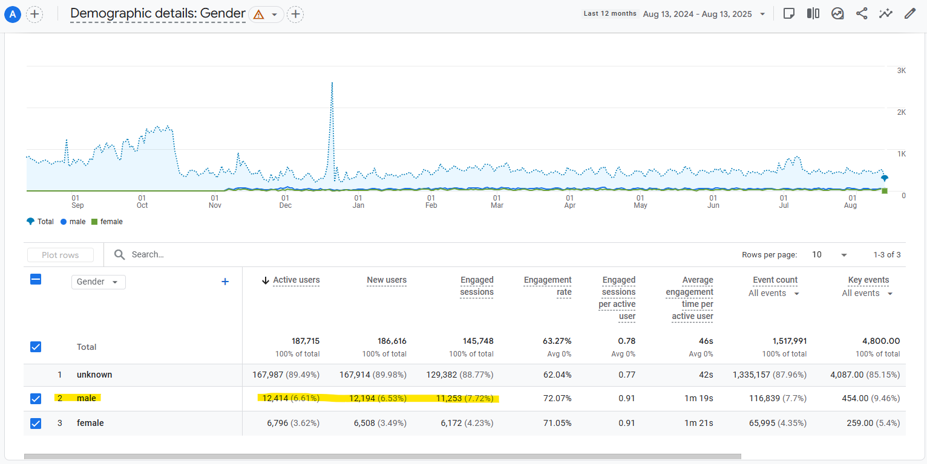
Shopify Demographics - Gender
Notes:
12 month snapshot at our Shopify demographics. Most Active, new users, and engaged customers fall in Jesse’s segment.

Slide 13
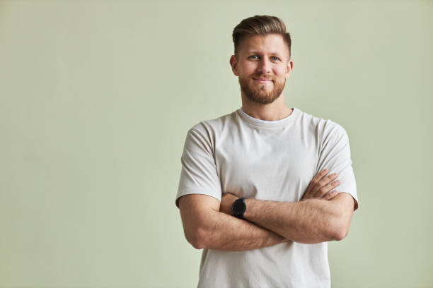
Target Customer: Jesse
32, WORKS IN TECH, GYM-GOER
Jesse has a full life - he spends his time working, working out and socializing with his girlfriend and friends.
● In his free time, he is into gaming, watching sports and listening to music and podcasts.
● He uses social media primarily for entertainment, watching sports, gaming content, and memes on TikTok and Instagram. He also follows a handful of fitness influencers and when researching a topic, he primarily looks to Reddit.
● At the gym he likes lifting weights and boxing. He likes to monitor his health and workouts through smart devices. He uses the data to help improve his gains. He has been taking creatine for several years.
Notes:
This is our primary shopify demo. The first launch is based on him

Slide 14
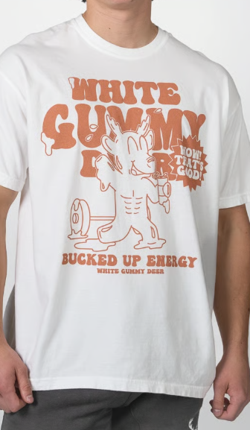
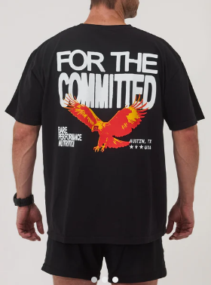
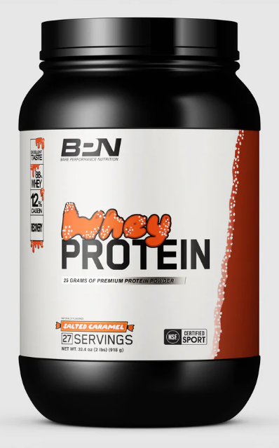
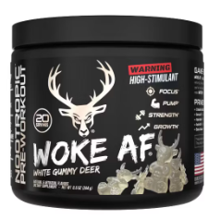
Mood Board
Created a visual mood board and mockups
to align the team on the final direction
Analyzed various brands to understand how they align with visual identity
Same color scheme
Same messaging
Eye-catching graphics not strictly within Viz ID

Slide 15
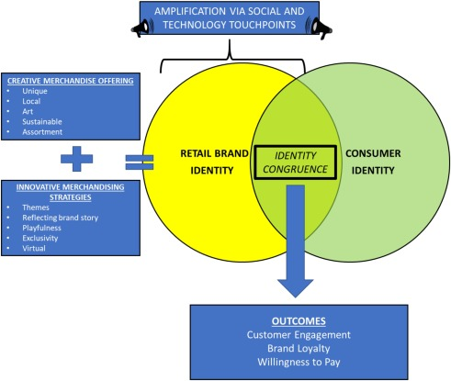
Here’s Why
Positions us as a trend-forward brand
We are competing with all clothing
People may not want to be a walking billboard
“Where did you get that”
Allows for our customers to identify with the brand on a personal level
  Gives our customers an opportunity to make CON-CRET a “part” of their identity
Roggeveen, A. L., et al. (2021). Forging meaningful consumer-brand relationships through creative merchandise offerings and innovative merchandising strategies. Journal of Retailing, 97(1), 81–98. https://doi.org/10.1016/j.jretai.2020.11.006
Notes:
I want to make it clear: WE ARE NOT BUCKED UP OR BPN
Merch is personal, it is as much about the consumer’s identity as it ours

Slide 16
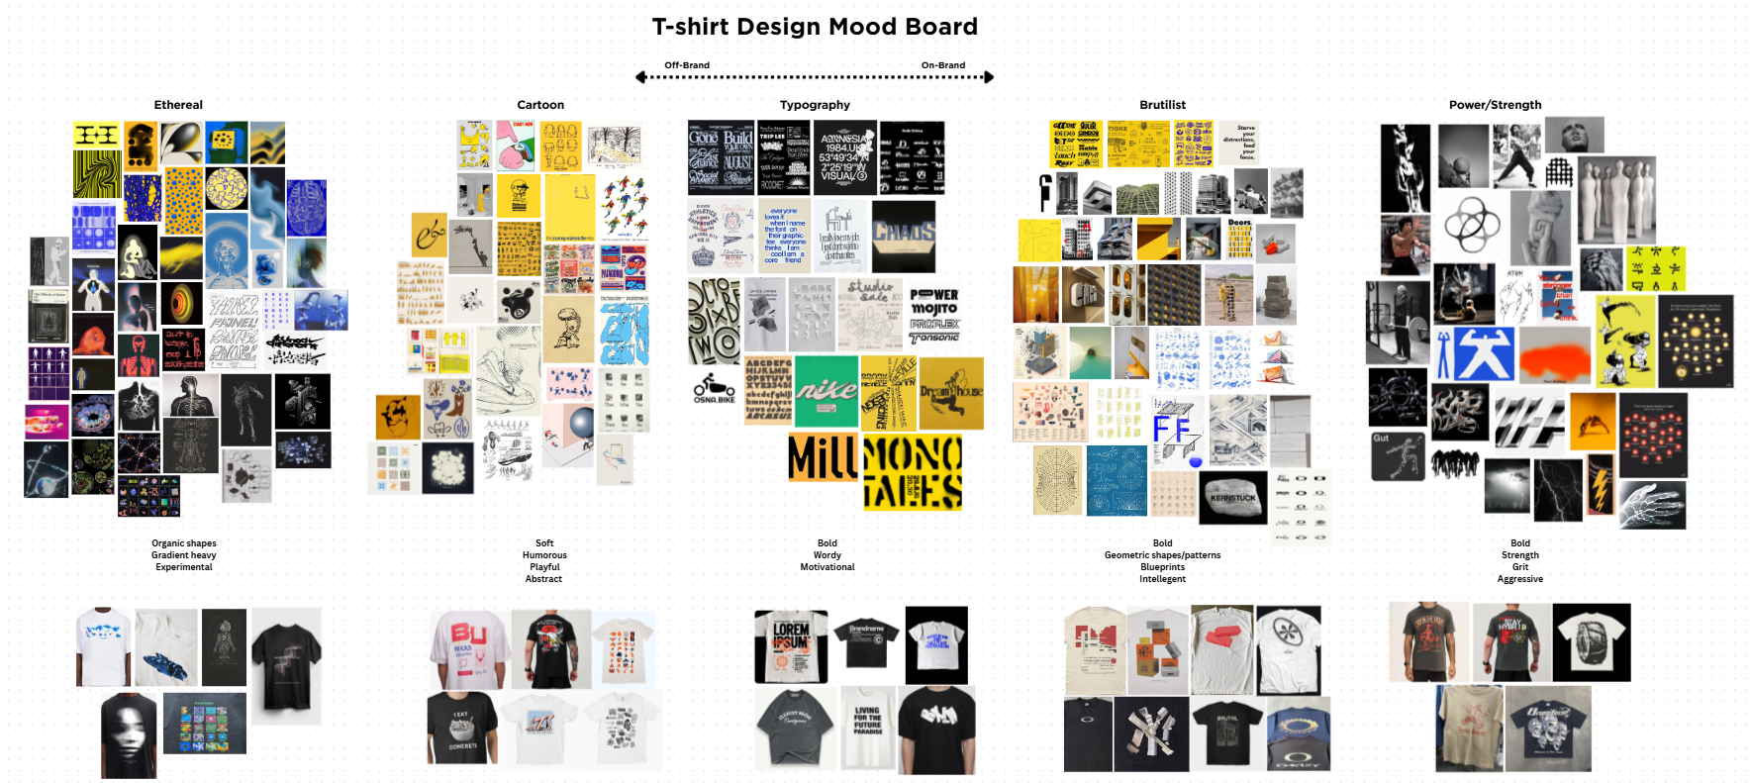
Notes:
These are starting points
Other ways we can show are brand

Slide 17
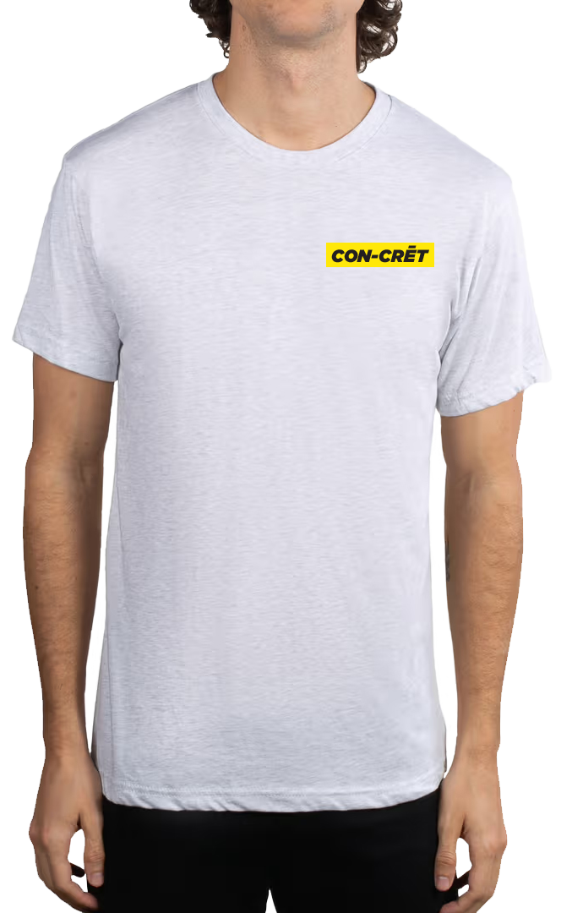
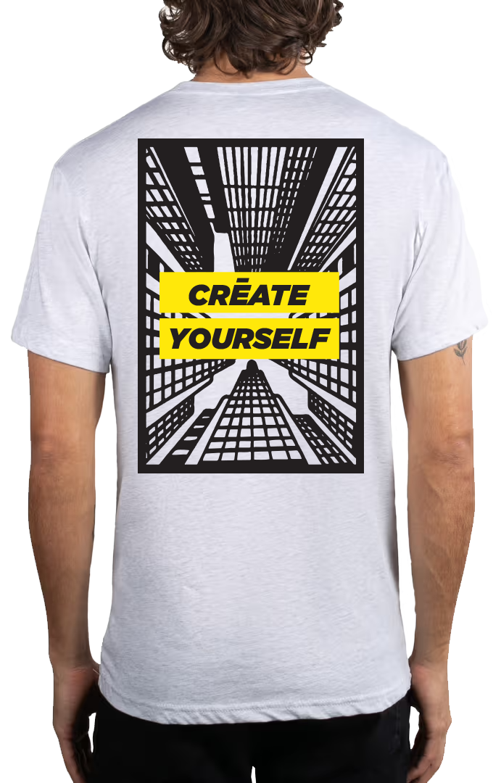

Slide 18
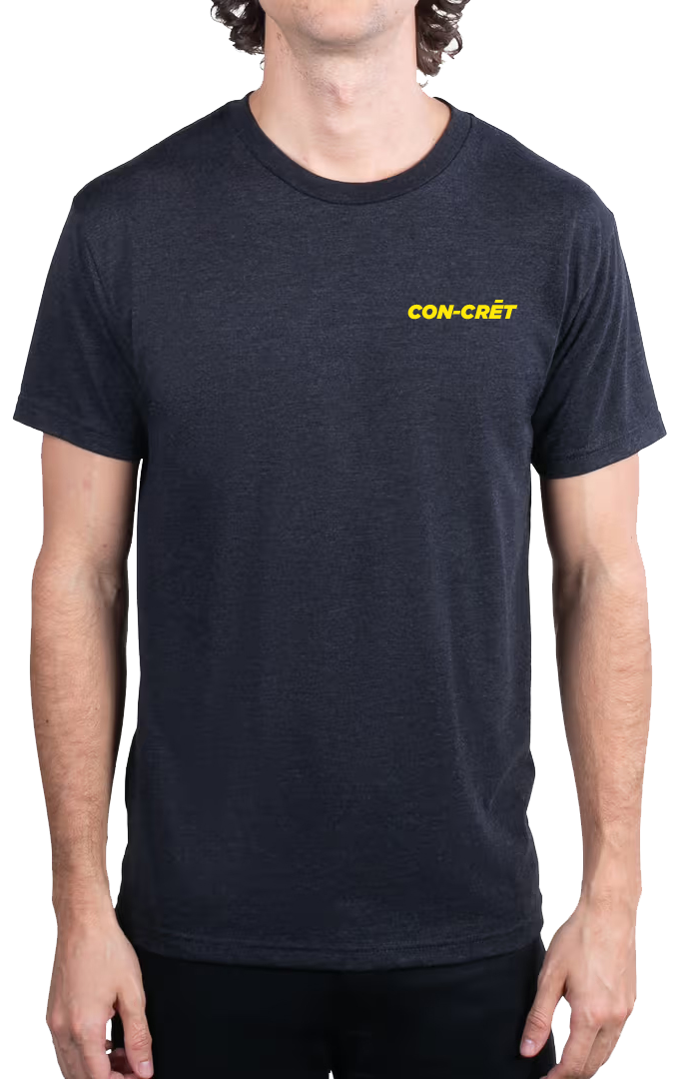
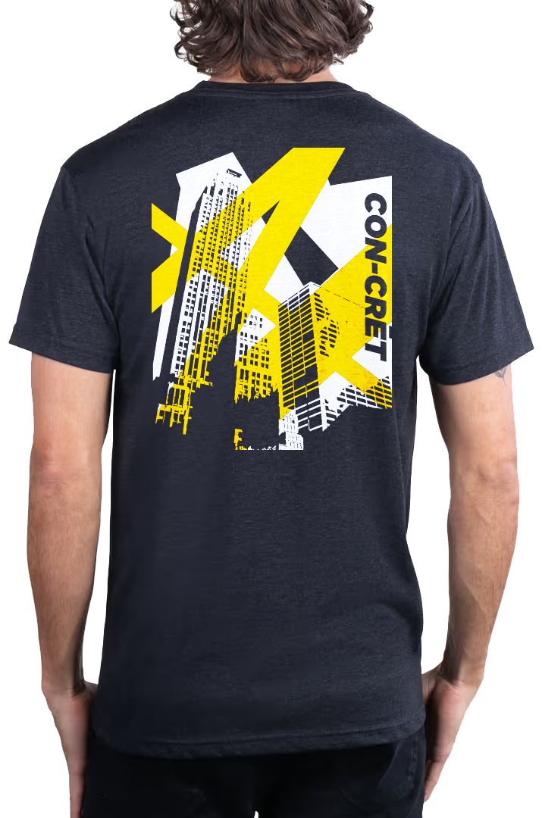
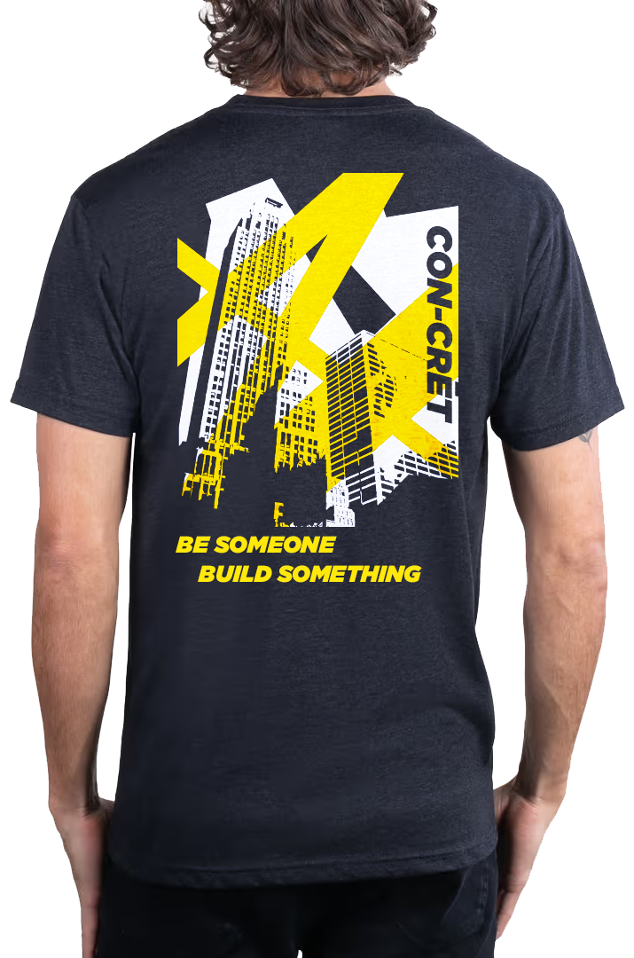

Slide 19
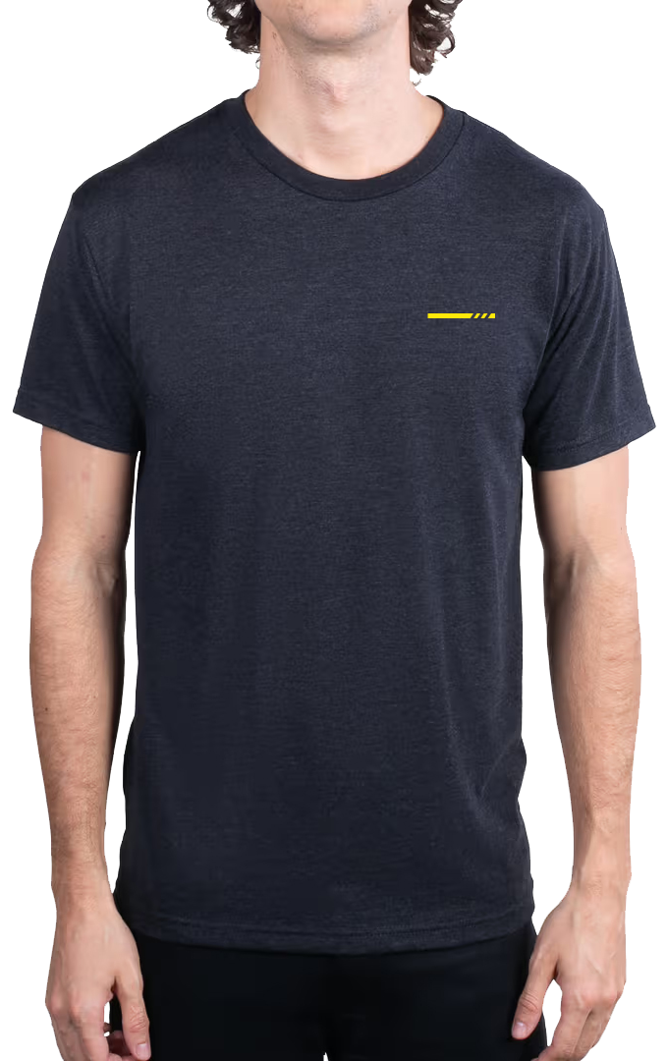
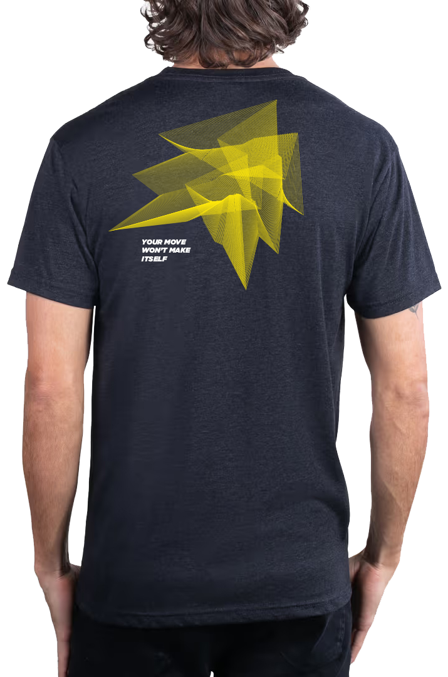

Slide 20
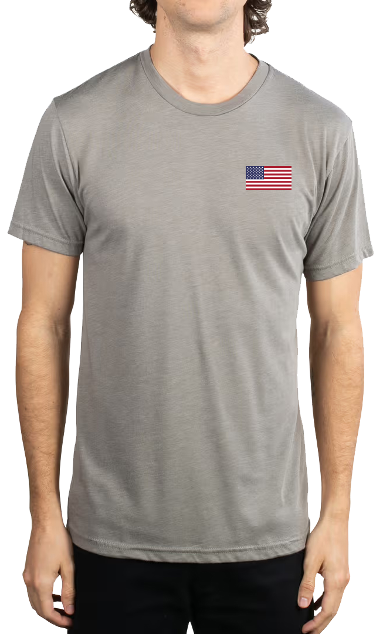
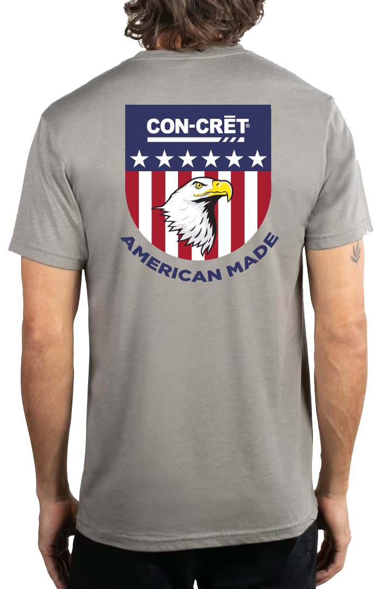

Slide 21
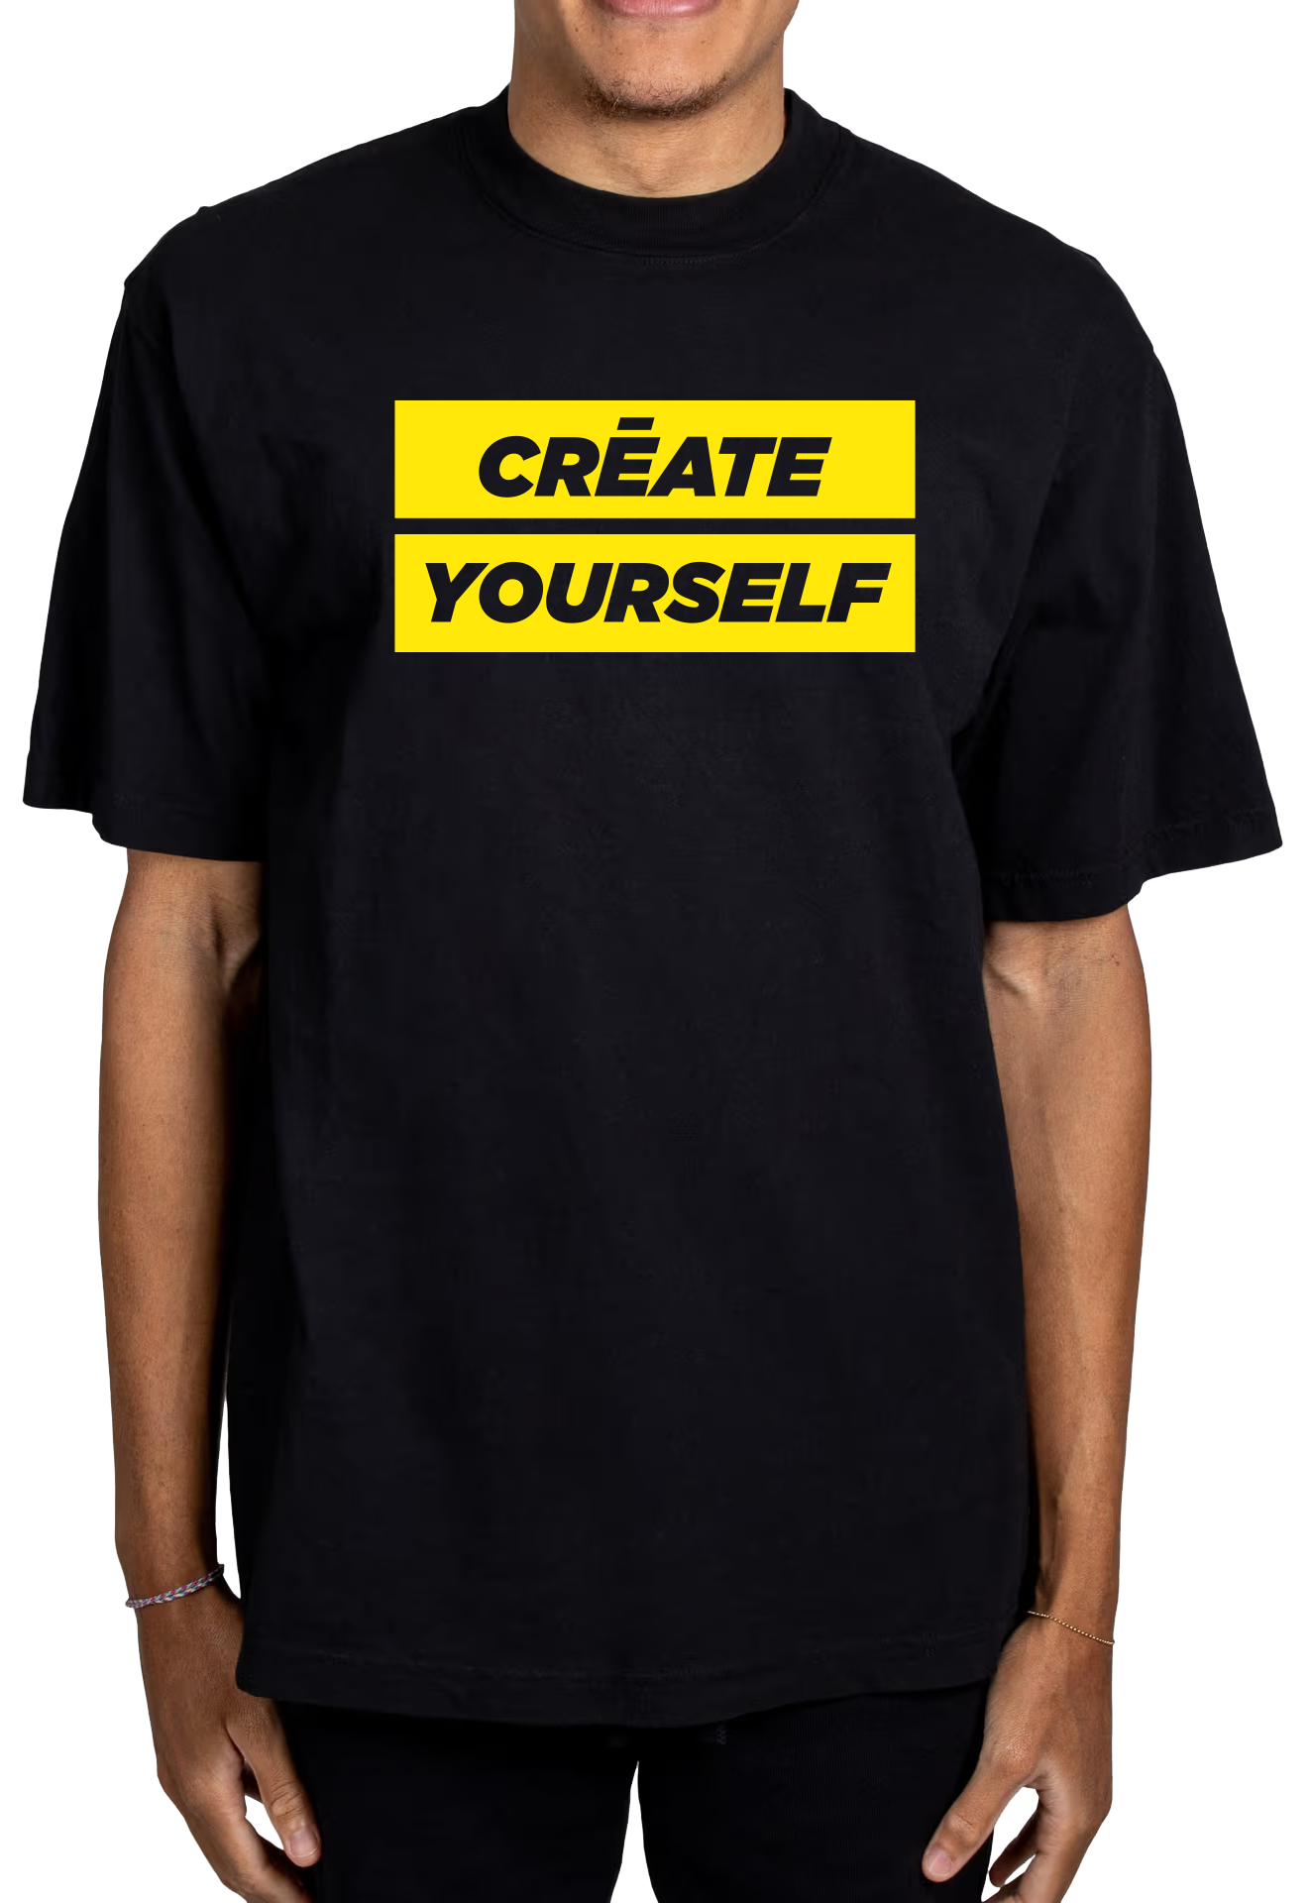
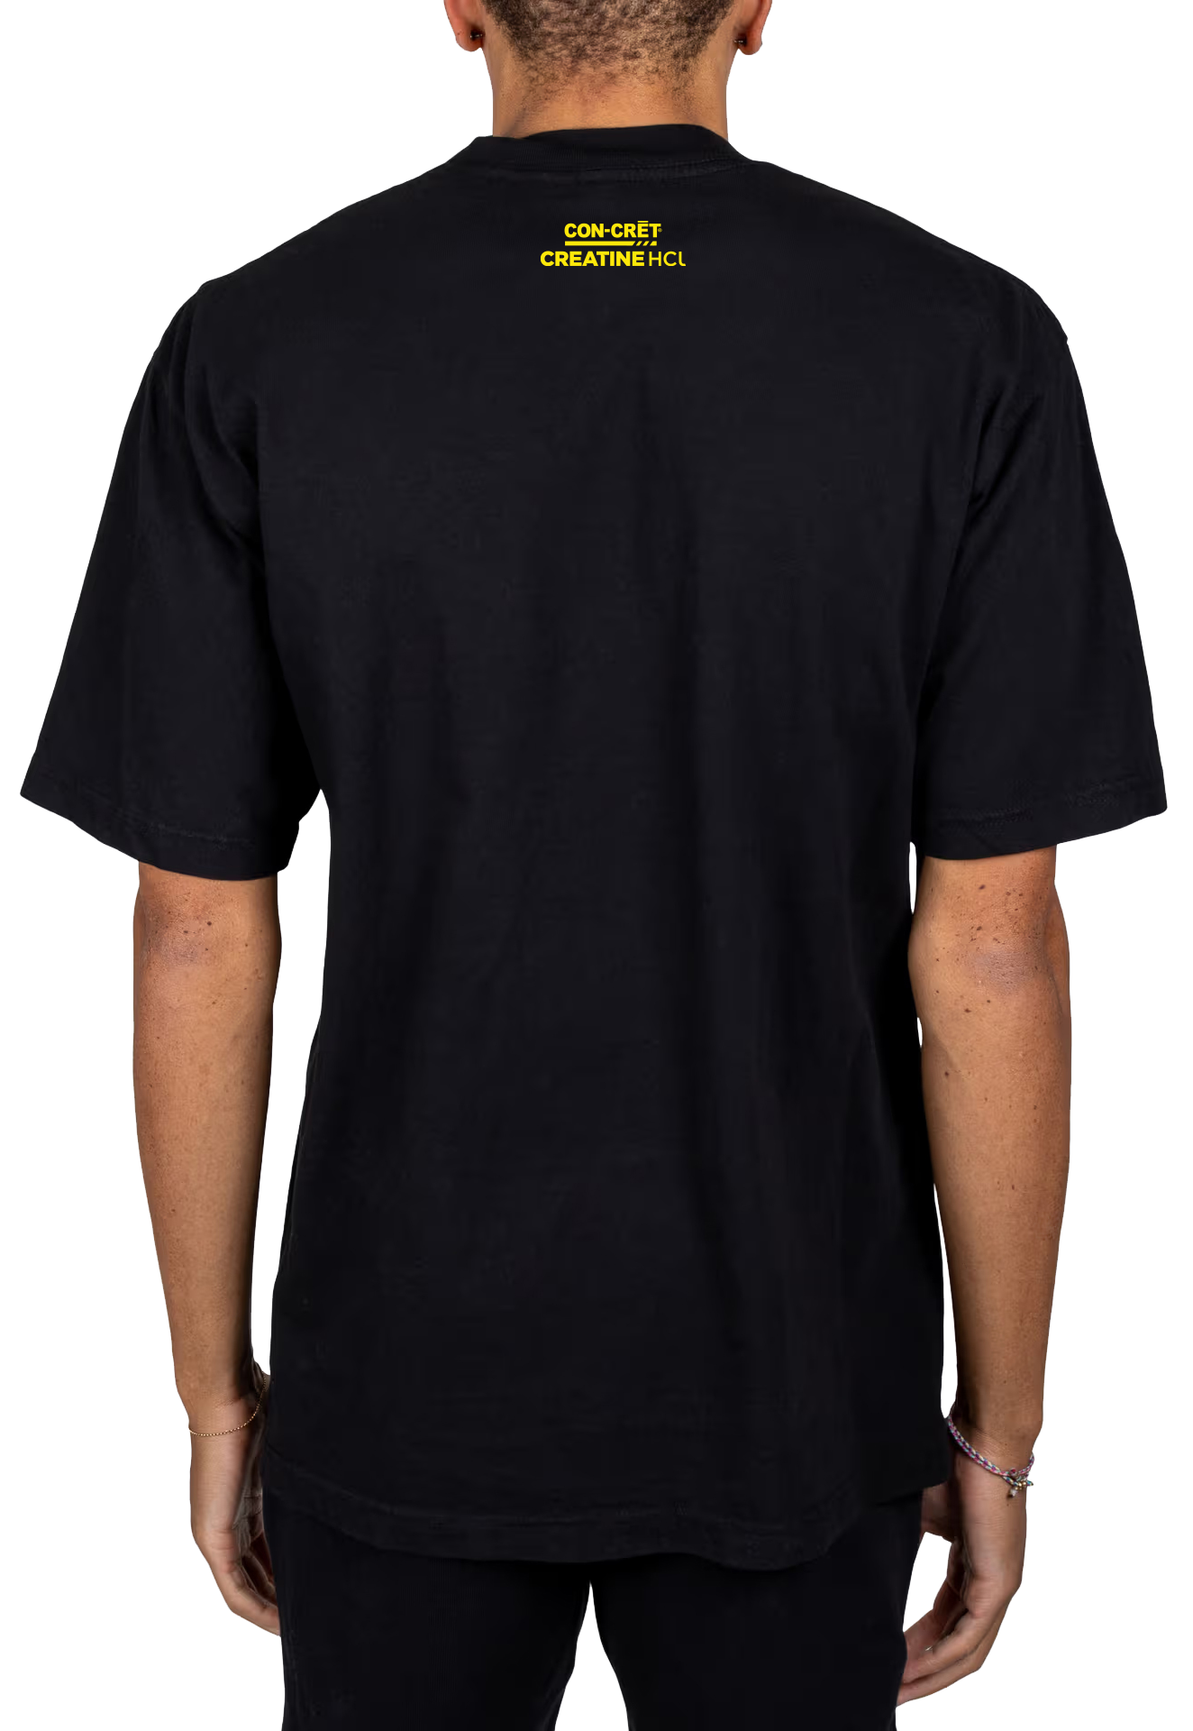

Slide 22
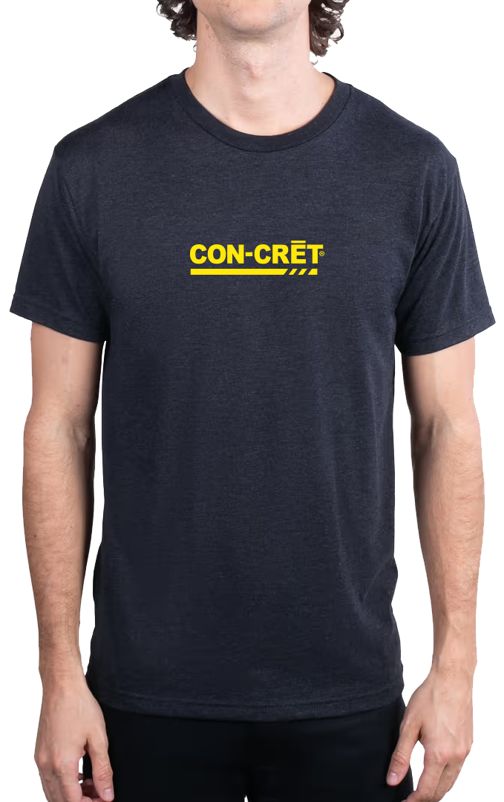


Slide 23
Vendor Sourcing
Researched and contacted multiple vendors for fulfillment
Compared vendors based on price, turnaround time, minimums, and quality
Ordered samples of products to determine ideal quality
Compared fulfillment options (Bulk vs. POD)
Notes:
{Pass out samples here}

Slide 24
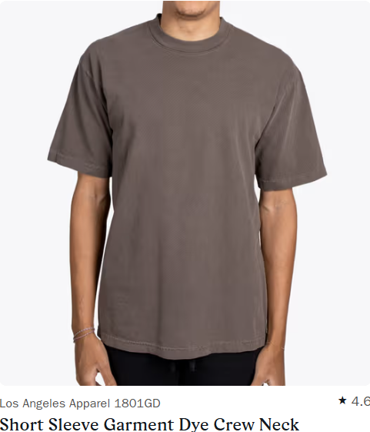
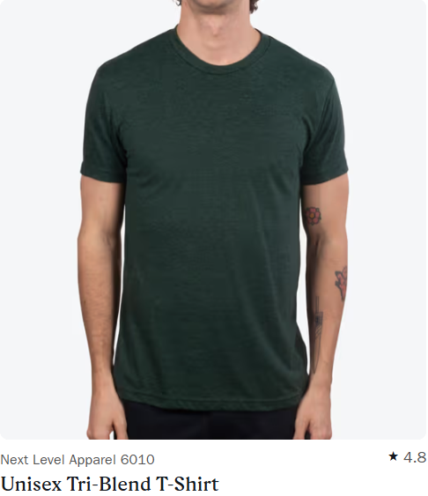

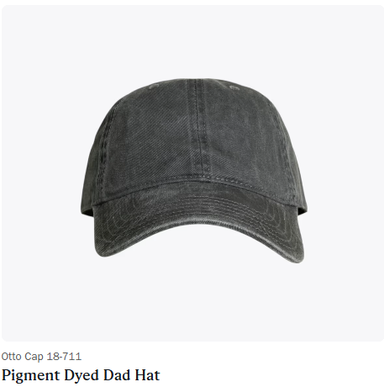
Vendor Sourcing Recommendation
Real Thread (traditional inv.)
100% Cotton T-shirt
Los Angeles Apparel 1801GD (USA)
(Front) 1 color print
(Back) 2 color print
Cost: $15.48
Performance T-Shirt
Next Level Apparel 6010
(Front) 1 color print
(Back) 1 color print
Cost: $11.36
Hat
Otto 18-711
(Front) 2 color embroidery
Cost: $12.26
Notes:
100% usa grown cotton
53% of consumers have a more favorable impression of U.S. made promo products

Slide 25
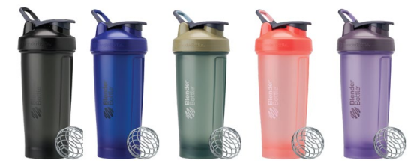
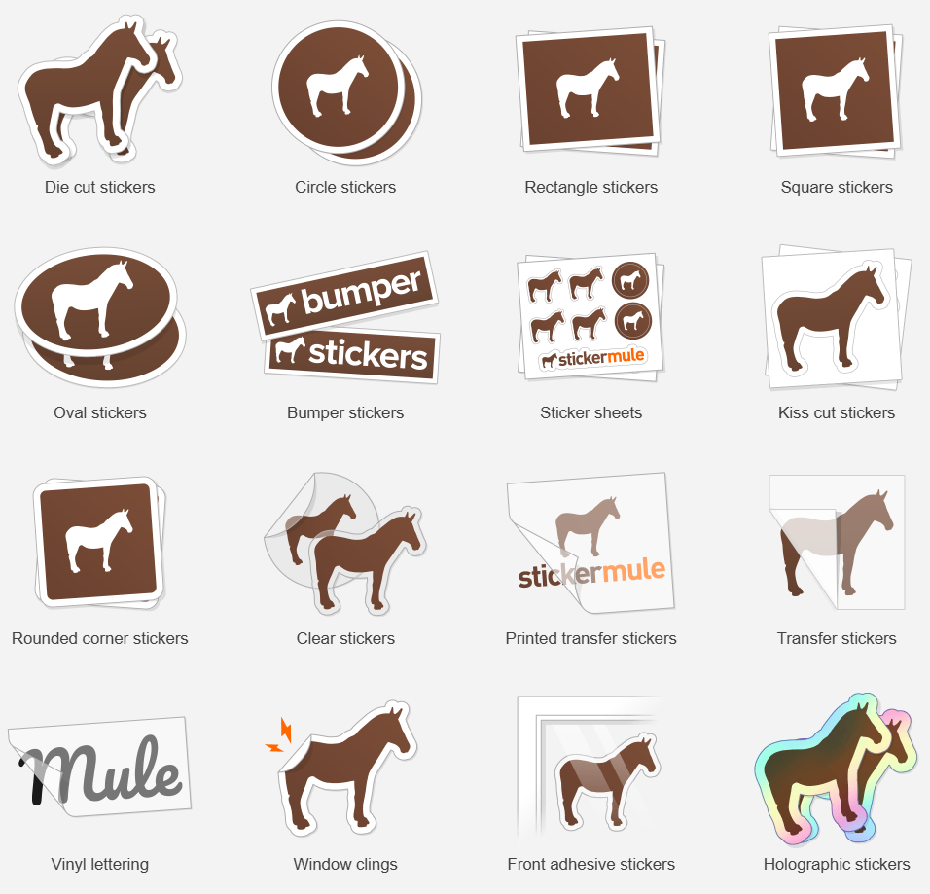
Vendor Sourcing Recommendation
Blender Bottle
V2 Bottle
Cost: 240 @ $6.44 each – $1545.60
Sticker Mule
Die-cut
Cost: $0.50/300 x 3 = $450.00
3 different stickers

Slide 26
Why Bulk vs POD
Greater quality control
Better margins per item
Avoid high fulfilment costs
Avoid having two shipping costs

Slide 27
Shipping
Collaborated with Daubby and the NE team to determine if shipping out of NE was feasible.
  Daubby spoke with his team and confirmed that all merch can be shipped in-house!
Research shows customers perceive products to have higher value when they come from the same factory*
Increase free shipping threshold from $40 to $65+
$43.35 + $22.79 = $66.14
This will increase AOV on Shopify
Encourages larger cart amounts
Increase sales of profitable merch SKUs
*Newman, G. E., & Dhar, R. (2014). Authenticity is Contagious: Brand Essence and the Original Source of Production. Journal of Marketing Research, 51(3)
Notes:
He had serval questions I was able to answer using my forecasting spreadsheet
Its personal

Slide 28
Benefits of Adding Merchandise
Merch is a marketing expense that will pay for itself
Brand new revenue stream w/ high margins
Increases Brand Visibility
Encourages Brand Loyalty
Content Opportunities
Encourages Bundle Deals and increases site health
Notes:
(i.e.,100 employees advertising our brand with t-shirts and hats)
According to a study by Nielsen, 92% of consumers trust recommendations from friends and family
We can repost fan stories and have influencers in our merch when they make content

Slide 29
  Launch Strategy & Tactics
Leverage Email and SMS channels
Homepage hero and pop-up banner
Give-away on socials
Influencer PR package
Organic promotion on socials
Paid social via Meta campaign
Preorder option to drive demand and interest
  Potential to break-even much sooner than month 5
  96% of people want to be informed in advance when companies offer promotional products.
Notes:
All to drive traffic to our site

Slide 30
Next Steps
Budget approval
Finalize designs
Order all product to NE
Net Suite Integration
Product Photos & UGC
Launch

Slide 31
Collaborators
Digital Team
  Brandon
  Griff
  Katie
  Eric
  Coco
  Aaliya
Creative Team
  Sonia
  Cara
  Justin
  Johnny
Opps
  Daubby
What I Learned
Professional:
First office experience
Effective workplace communication
Merch development
Personal:
Confidence
Organization
Attention to detail

Slide 32
Thank you!
Notes:
Brandon
Justin
Yessina and Cole

Slide 33
Questions?

